Slide 1
UDuino
By: Duncan McCloud, Matthew Ward, Debraj Bhowmik, Charles Ciraolo

Slide 2
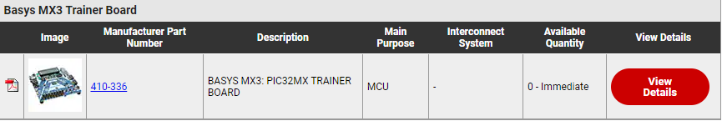
Background
The BASYS MX3 board is no longer in production and our group decided to create a replacement board with the intention of similar functionality and additional features.
We wanted our board to be the same or lower price than the BASYS board which could cost students up to a $100
We ended up calling it Uduino because our board also has a Arduino footprint and supports Arduino implementation on to the board.

Slide 3

Spring Update
During this semester, we were able to get the board and were able to populate it with all the peripherals and components that we ordered from Digikey, JLC PCB and TechDesign. These are some of the requirements that were given to us initially that we were able to meet.
32-bit processors
General purpose IO that can serve as analog input, digital input and digital output.
Has integrated LCD
CN Interrupt and timer support through co-processors
ADC support
Has sufficient main memory size (32KB at least)
Allows the use of heap (dynamic memory)

Slide 4
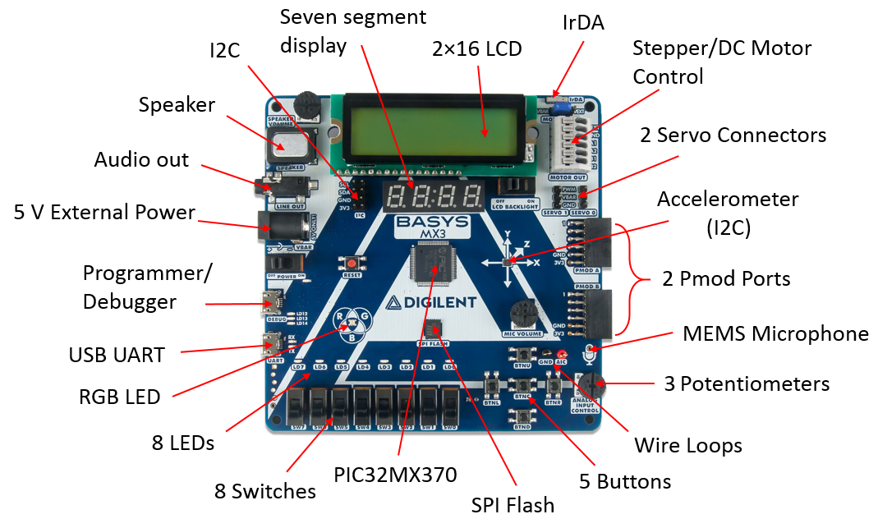
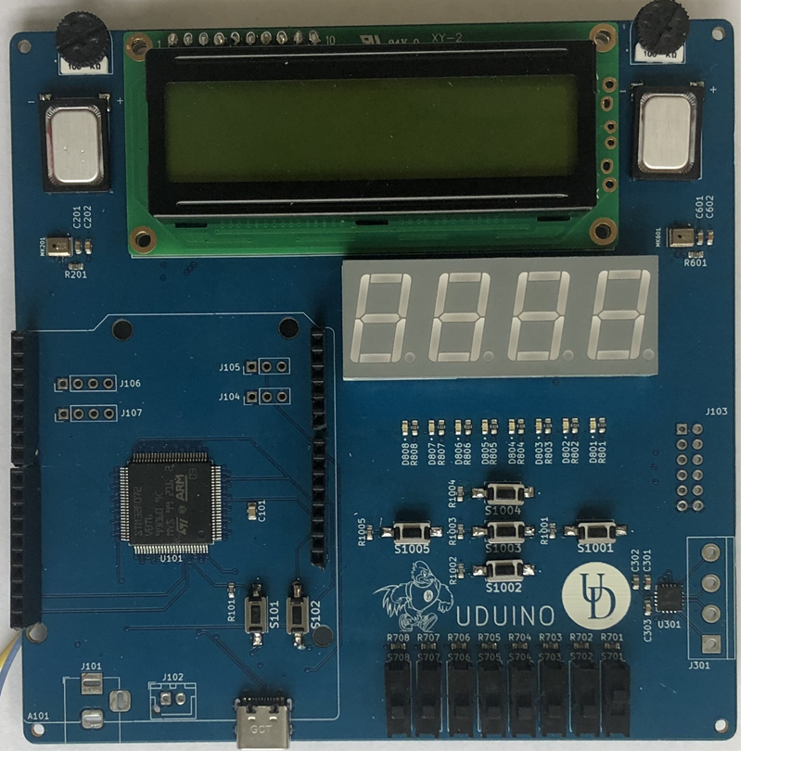
BASYS MX3
UDUINO (populated)
Blue Hens Logo

Slide 5
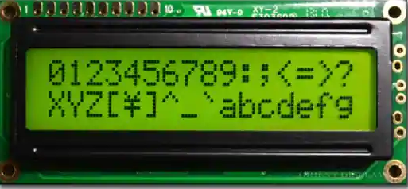
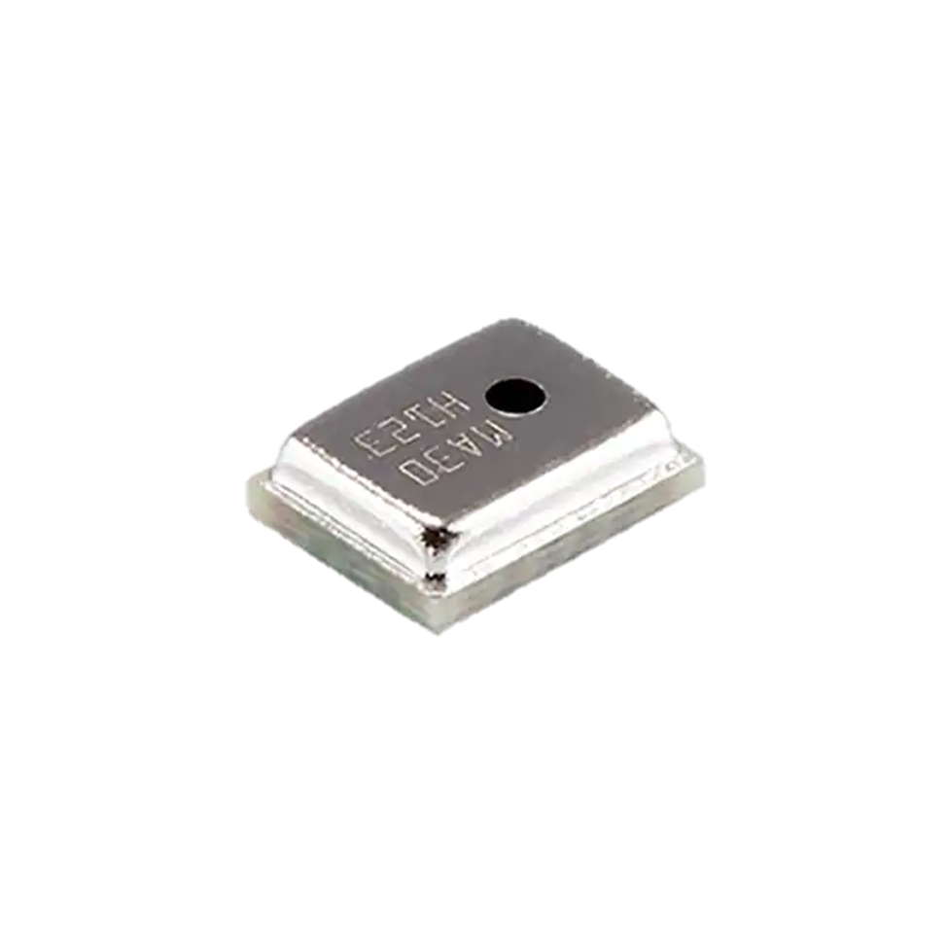
Bill of Materials
Function Part Number Connection type Price
LCD Display AMC1602AR-B-Y6WFDY-SPI SPI $12.90
8 slide switches EG1903-ND Digital $0.76
SSD 67-1449-ND Digital $9.08
Speaker AS01508MS-SC11-WP-R Analog $2.06
Potentiometer 3352T-104LF-ND Analog $2.50
8 LEDs 160-1436-2-ND PWM, Digital, or Analog $0.24
5 Buttons PTS636 SL43 LFS Digital $0.01
DC Motor Controller TB67H400AFTG,EL Digital & PWM $3.51
Audio Amplifier NAU8315YG I2S $1.06
Microphone CMM-4030D-261-I2S-TR I2S $2.66
Microcontroller STM32F072VBT6 N/A $6.82

Slide 6
Bill of Materials(Continued)
Function Part Number Connection type Price
Buck Converter AP63203WU-7, AP63205WU-7 N/A $1.82
Motor Driver 296-29398-2-ND $2.39
----------------------------------------------------------------------------------
TOTAL PRICE = $62.04

Slide 7
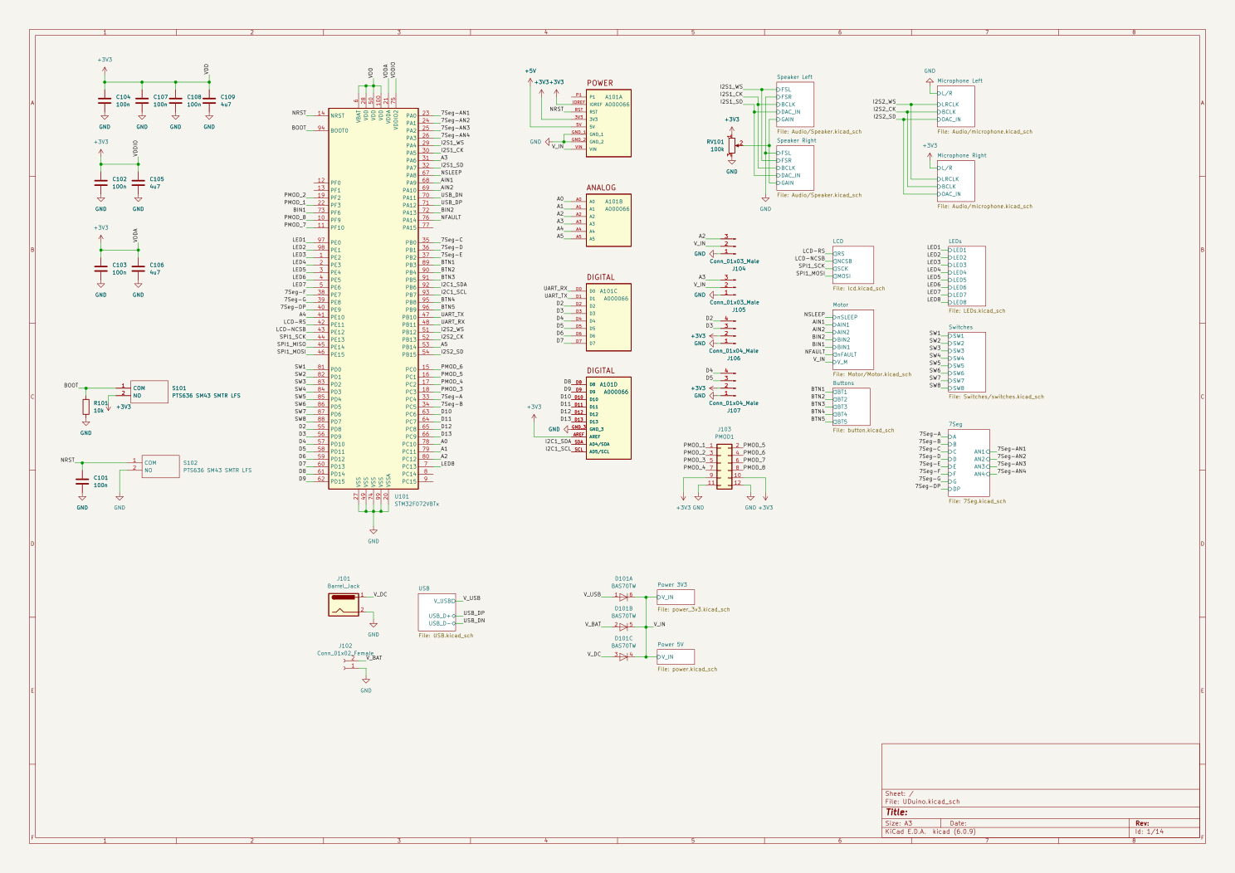
Schematic

Slide 8
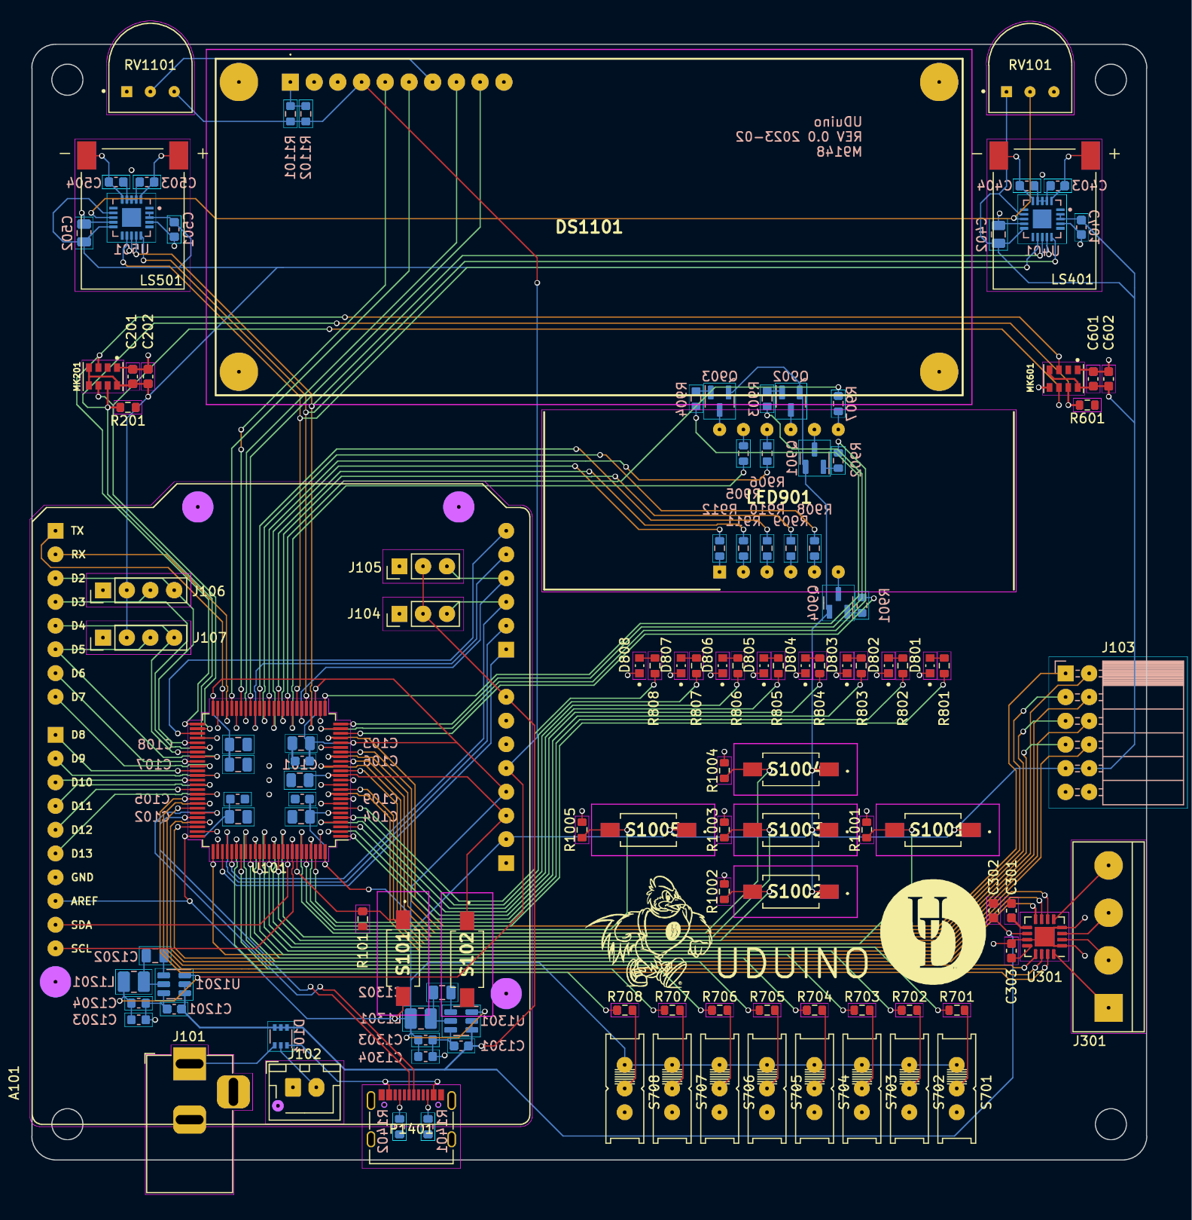
Our Design
2x16 LCD
LCD Backlight Dimmer
7 Segment Display
Speaker Volume
Left Speaker
Right Speaker
Left Microphone
Right Microphone
Grove Connectors
Servo connectors
PMOD
Microcontroller
Motor Controller
Arduino Footprint
3v and 5v regulators
LEDs
Switches
Buttons

Slide 9
I/O Comparison
Basys MX3
16 x 2 Character LCD
4 Digit, 7 Segment Display
Speaker, Microphone
8 LEDs
8 Switches
5 Push Buttons
2 PMOD
2 Servos
Dual DC Motor Controller
I2C, UART
Digilent Analog Discovery
UDuino
16 x 2 Character LCD
4 Digit, 7 Segment Display
2x Speakers, 2x Microphones
8 LEDs
8 Switches
5 Push Buttons
1 PMOD
2 Servos
Dual DC Motor Controller
I2C, UART
SWD, JTAG
Arduino Footprint

Slide 10
Microcontroller Comparison
PIC32MX370F512L
MIPS32
32-Bit Single Core
80 MHz
85 GPIO
I2C, SPI, UART
512 KB Flash
128 KB Ram
STM32F072VBT6
ARM Cortex-M0
32-Bit Single Core
48 MHz
87 GPIO
I2C, SPI, UART, USB
128 KB Flash
16 KB Ram

Slide 11
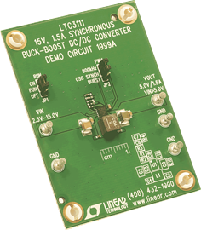
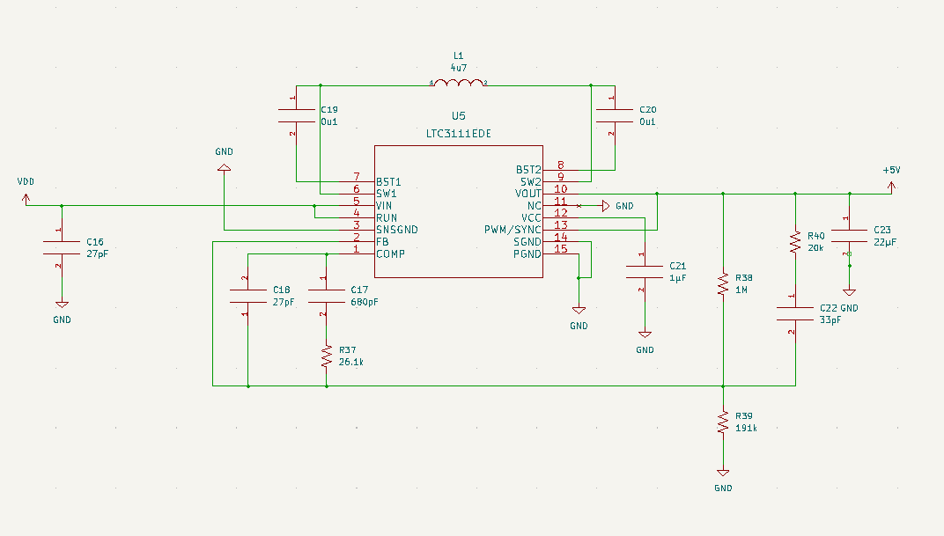
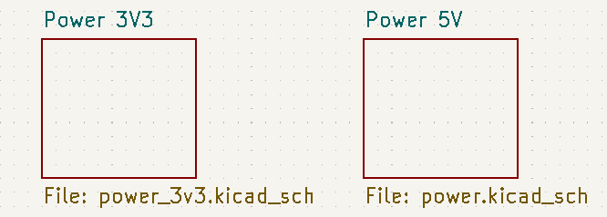
Power Supply
The Basys MX3 could only operate on a 5V power source from
Programming / Debugging USB port , the USB-UART, or an external 5V DC power supply that’s connected to a Power Jack
Able to use wall plugin or lithium ion battery to power our board
We were able to take up to a maximum 24 V of power for our board

Slide 12
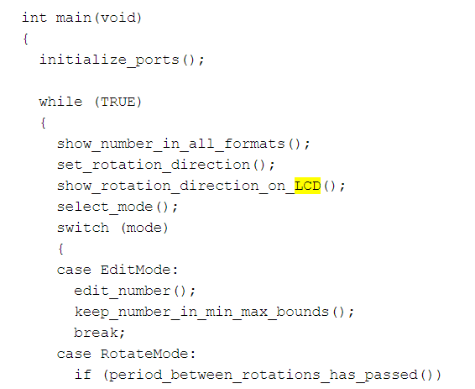
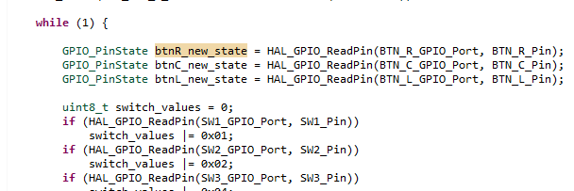
IDE / Programming / Debugger
STM32CubeIDE
C/C++
Based on Eclipse
Hardware Debugger w/ JTAG
Old Code
Using the new Programmer

Slide 13
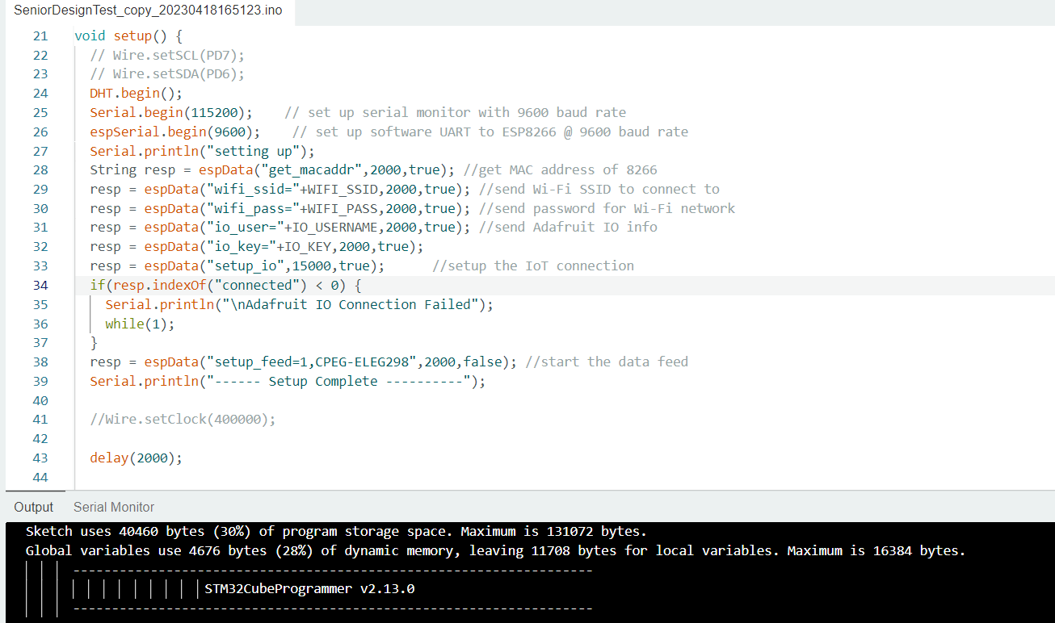
IDE / Programming
Arduino
C/C++

Slide 14
Improvements
Map a few of the pins that are overlapping separately so that the corresponding peripherals can be run at the same time
Move the reset button outside of the Arduino shield for usage with the Arduino
Look into the issue with the usb-c programming only working with a usb hub (most likely a problem with the microcontroller itself)
Build an onboard usb hub onto our board to fix the issue of not connecting
Fix wiring issues (wires on the back)
Power Problems ( Schottky Diodes, Buck/Boost )

Slide 15
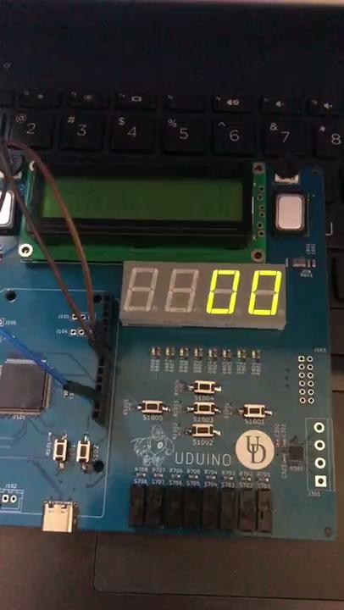
Labs
Lab 1: A number converter with the ability to rotate numbers bit by bit

Slide 16
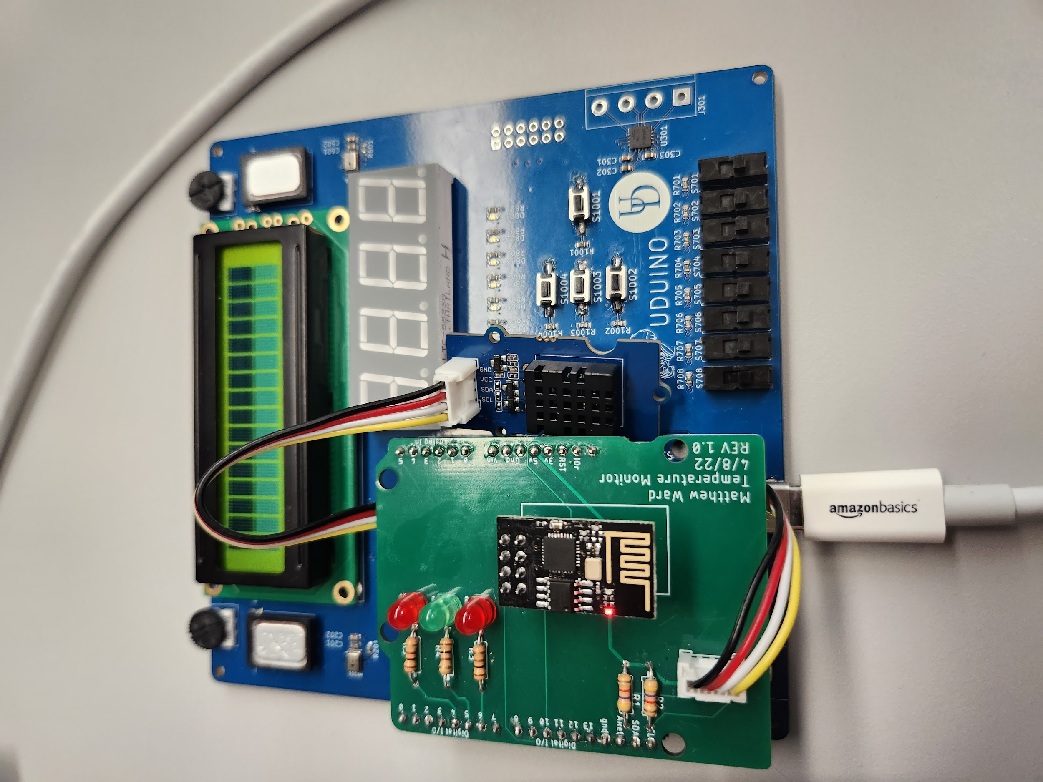
Labs
Driving Robot
Sophomore / Junior Design Projects

Slide 17
References
https://digilent.com/reference/_media/reference/microprocessor/basys-mx3/basys_mx3_rm.pdf
https://www.digikey.com/

